Slide 1
Oh, The Places You’ll Go!
By Jen Eubank and Lacen Kinkel

Slide 2

NOTE:
To change images on this slide, select a picture and delete it. Then click the Insert Picture icon
in the placeholder to insert your own image.
Congratulations!
Today is your day.
You’re off to Grad School!
You’re off and away!

Slide 3
You have brains in your head.
You have feet in your shoes.
You can steer yourself any direction you choose.
You’re on your own. And you know what you know.
And YOU are the graduate who’ll decide where to go.

Slide 4

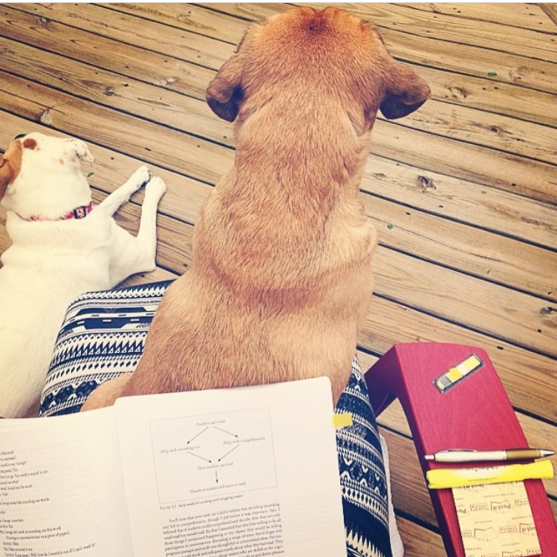
NOTE:
To change images on this slide, select a picture and delete it. Then click the Insert Picture icon
in the placeholder to insert your own image.
You’ll look up and down syllabi. Look ‘em over with care.
About some you will say, “My accomplishments I must share.”
With your head full of brains and your shoes full of feet,
you’re too smart to assign any old worksheet.

Slide 5
NOTE:
To change images on this slide, select a picture and delete it. Then click the Insert Picture icon
in the placeholder to insert your own image.
After our first summer semester, we learned all sorts of things.
We became preventing reading difficulties, middle school, and content literacy kings.

Slide 6

NOTE:
To change images on this slide, select a picture and delete it. Then click the Insert Picture icon
in the placeholder to insert your own image.
One semester down, and two to go.
Who knew the fall semester would make us say, “Oh no!”

Slide 7
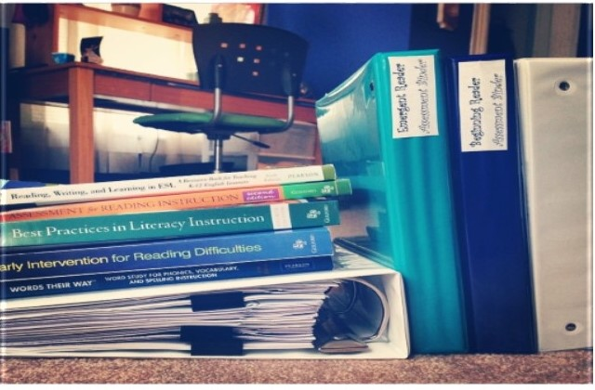
NOTE:
To change images on this slide, select a picture and delete it. Then click the Insert Picture icon
in the placeholder to insert your own image.
Course work gets heavy, as it frequently does,
remember how easy undergrad was?

Slide 8
NOTE:
To change images on this slide, select a picture and delete it. Then click the Insert Picture icon
in the placeholder to insert your own image.
And then assignments start growing, don’t worry. Don’t stew.
Just go right along,
You’ll start growing, too.
OH! THE PLACES YOU’LL GO!

Slide 9
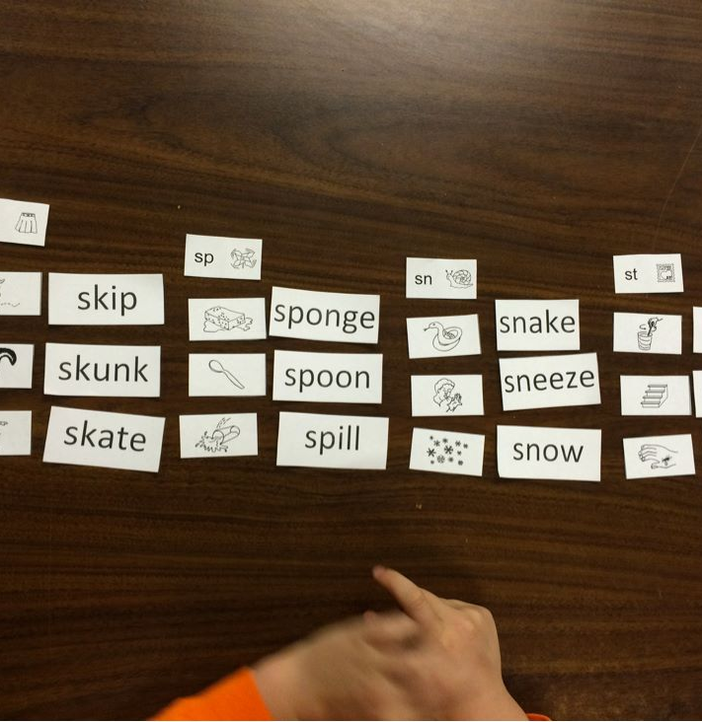
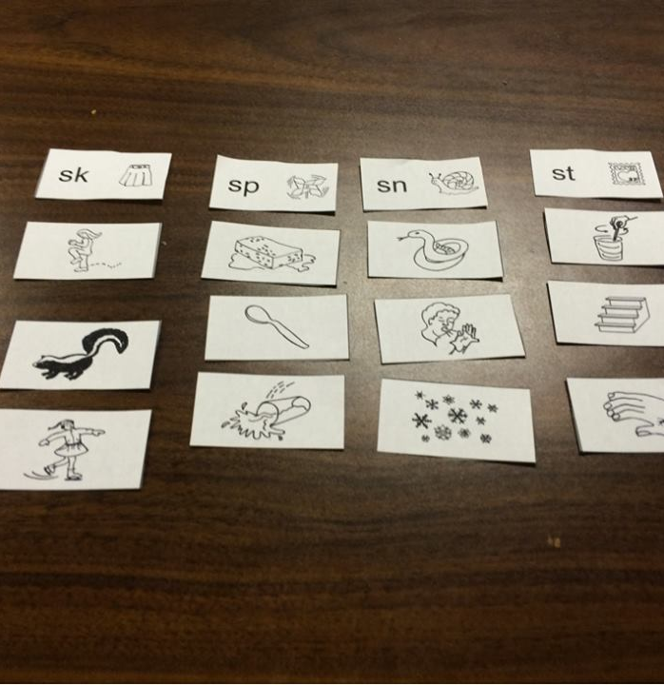
NOTE:
To change images on this slide, select a picture and delete it. Then click the Insert Picture icon
in the placeholder to insert your own image.
You’ll be well on your way up!
You’ll be seeing great sights!
You’re tutoring kiddos will soar to incredible heights.

Slide 10
NOTE:
To change images on this slide, select a picture and delete it. Then click the Insert Picture icon
in the placeholder to insert your own image.
ELL, Word Study, and research made us want to YELP!
But our newly gained knowledge has been such a help.

Slide 11
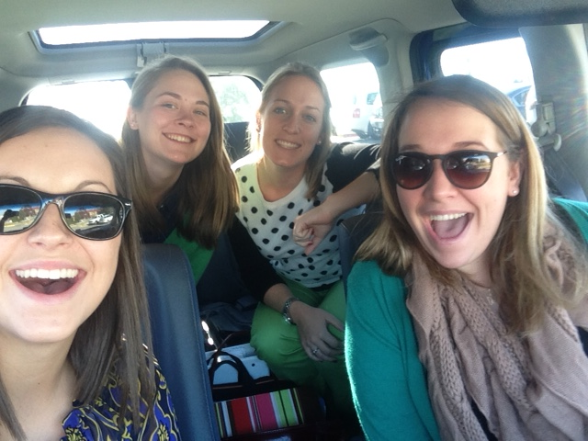
NOTE:
To change images on this slide, select a picture and delete it. Then click the Insert Picture icon
in the placeholder to insert your own image.
You won’t fall behind, because you’ll have other friends in need.
Your PALs are here for you to help you succeed.
Wherever you go, you’ll be best of the best.
We all know RLL is better than the rest.

Slide 12


NOTE:
To change images on this slide, select a picture and delete it. Then click the Insert Picture icon
in the placeholder to insert your own image.
We’re sorry to say but, sadly, it’s true that Bang-ups and Hang-ups
will happen to you.

Slide 13
NOTE:
To change images on this slide, select a picture and delete it. Then click the Insert Picture icon
in the placeholder to insert your own image.
You will get all hung up in the late night work.
And you’ll feel like you have a permanent smirk.

Slide 14

NOTE:
To change images on this slide, select a picture and delete it. Then click the Insert Picture icon
in the placeholder to insert your own image.
But your smirk will begin to fade away.
As frequent connections in class are made every day.

Slide 15

NOTE:
To change images on this slide, select a picture and delete it. Then click the Insert Picture icon
in the placeholder to insert your own image.
Because graduate students with such a smirk are not much fun.
And un-smirking yourself is not easily done.

Slide 16
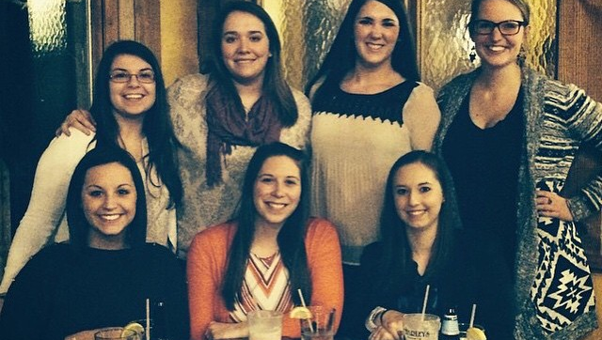
NOTE:
To change images on this slide, select a picture and delete it. Then click the Insert Picture icon
in the placeholder to insert your own image.
You will come to a place where the light starts to shine.
And we’ll spend our Wednesdays in the pasta bar line.
Here we discuss the future to come.
Do you dare to apply? Do you cry to your mum?
Do you dare to look back from the places we’ve come?

Slide 17
You’re spring semester is here! Woo-hoo and Hooray!
You’re one step closer to graduation day.

Slide 18
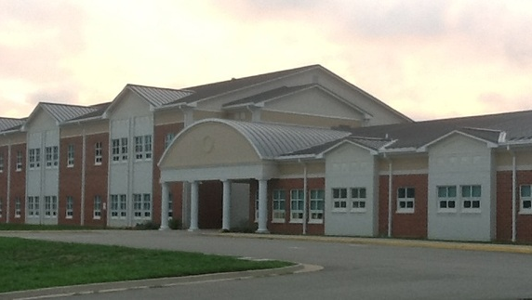
NOTE:
To change images on this slide, select a picture and delete it. Then click the Insert Picture icon
in the placeholder to insert your own image.
With tutoring this time you’re not sure you’ll fly high!
Middle school is a whole other world for these guys!
But you’re ready because you understand why.

Slide 19

NOTE:
To change images on this slide, select a picture and delete it. Then click the Insert Picture icon
in the placeholder to insert your own image.
Oh, the places you’ll go!
There’s reflecting to be done!
There are assessments to be scored.
You’ll sure analyze a ton.
And the things you can do now as a leader and writer will make teaching things all the more brighter.

Slide 20


NOTE:
To change images on this slide, select a picture and delete it. Then click the Insert Picture icon
in the placeholder to insert your own image.
Prepared! You’ll be as prepared as prepared can be,
with your professors watching you grow and succeed.
For example, you’ll shine at VSRA.
Then the stress of presenting will all go away.

Slide 21
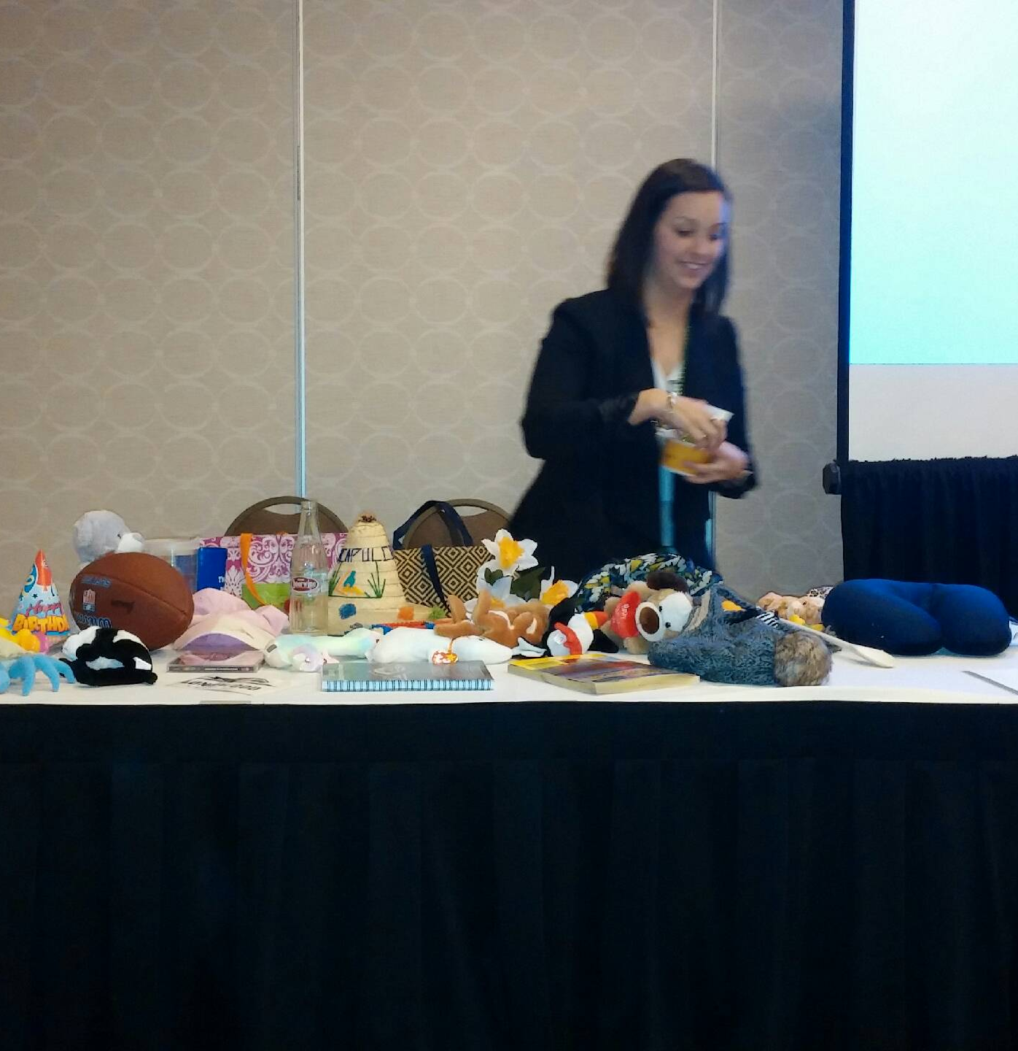

NOTE:
To change images on this slide, select a picture and delete it. Then click the Insert Picture icon
in the placeholder to insert your own image.
The participants will love you as you share what you know.
You will have a bunch of great pictures, thanks to Dr. Snow.

Slide 22

NOTE:
To change images on this slide, select a picture and delete it. Then click the Insert Picture icon
in the placeholder to insert your own image.
All together!
Whether you like it or not,
Group Canvas discussions we’ll do quite a lot.

Slide 23
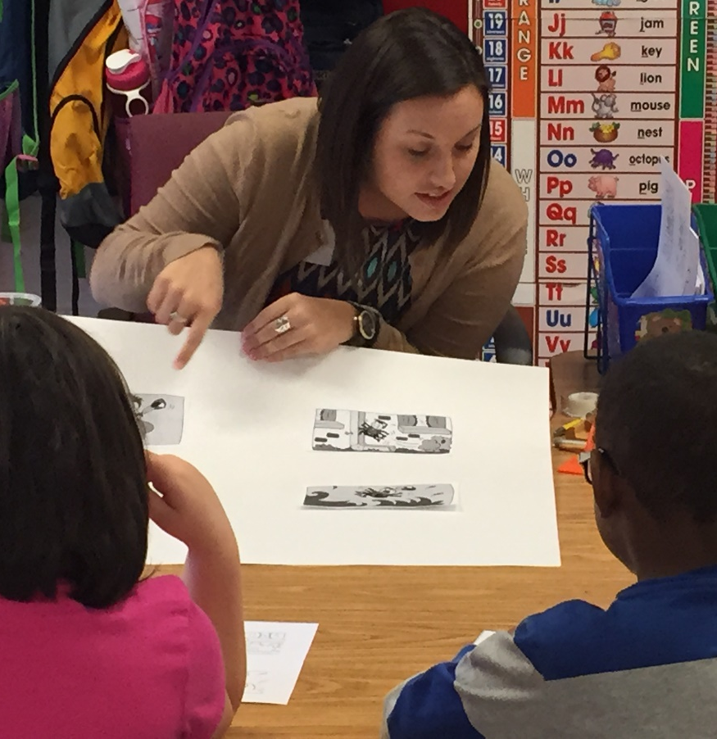
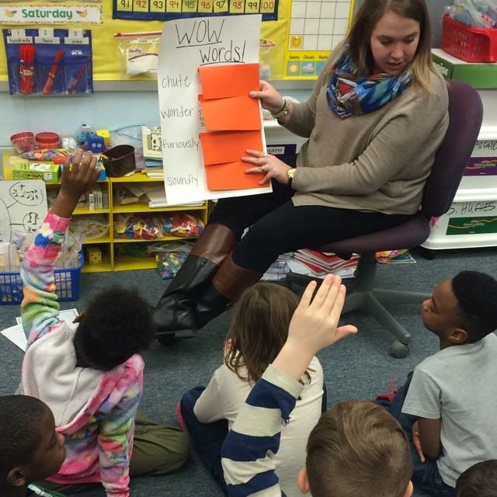
NOTE:
To change images on this slide, select a picture and delete it. Then click the Insert Picture icon
in the placeholder to insert your own image.
In your course work this spring, there’s a very good chance
you completed things that scared you at first glance.
Observations and demo lessons made us nervous no doubt,
but we now realize what coaching is truly about.

Slide 24
As May approaches and graduation is near, you no longer have anything left to fear.
Our teaching portfolios are finally complete.
They are organized, colorful, and ever so sweet.

Slide 25
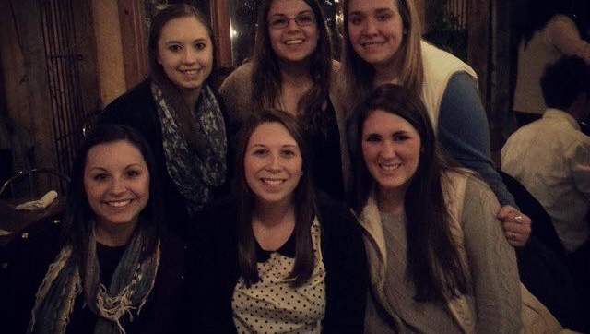
NOTE:
To change images on this slide, select a picture and delete it. Then click the Insert Picture icon
in the placeholder to insert your own image.
Now is the time to find your dream career,
so you can hang with your PALs and have a great cheer!

Slide 26

NOTE:
To change images on this slide, select a picture and delete it. Then click the Insert Picture icon
in the placeholder to insert your own image.
There are so many applications that you have to fill out,
You may even start to feel very unhappy and pout.

Slide 27

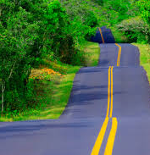
NOTE:
To change images on this slide, select a picture and delete it. Then click the Insert Picture icon
in the placeholder to insert your own image.
The road to get hired is a long one indeed.
But don’t fret graduates, you’re destined to succeed!
98 and ¾ percent guaranteed.

Slide 28
Before we finish it’s important that we give thanks to you all.
We’ve stuck it out through an entire year-long haul.
To Dr. Braun, Dr. Blanchette, and Dr. Snow, thank you so much for helping us grow.

Slide 29
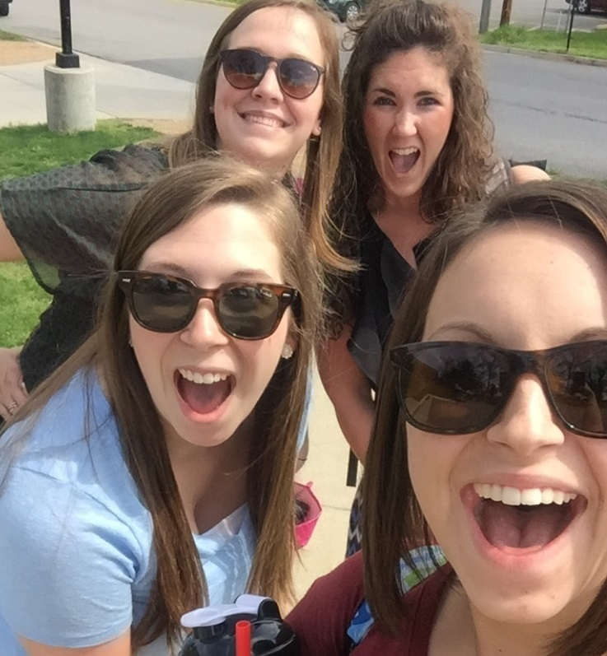

NOTE:
To change images on this slide, select a picture and delete it. Then click the Insert Picture icon
in the placeholder to insert your own image.
To our fellow RLL graduate friends,
thank you for helping us reach the journey’s end.

Slide 30
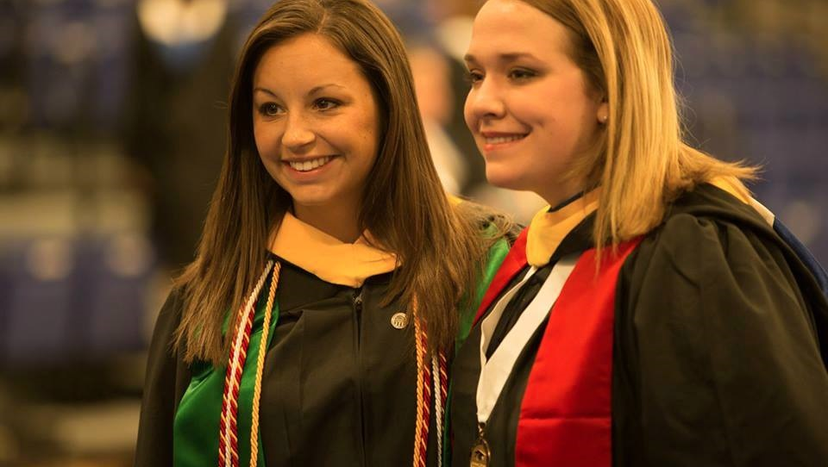
NOTE:
To change images on this slide, select a picture and delete it. Then click the Insert Picture icon
in the placeholder to insert your own image.
As we leave Longwood, we’ll step with care and great tact.
And remember the Life’s a Great Balancing Act.

Slide 31
So…
Be your name Eli or Leighann or Kellay
Or Gretchen or Snow or even Blanchea.
You’re off to Great Places! Today is your day!
Your classroom is waiting. So…get on your way!

Slide 32
THE END!

