Slide 1
Literacy plan
By Jennifer Eubank and Mary Lacen Kinkel
Notes:
Lacen

Slide 2
Section I: Contextual Information
Cumberland County
Rural community in southern Virginia
Three public schools (Elementary, Middle, & High)
Approximately 723 students enrolled in Pre-K through 4th
Cumberland Elementary is “Accredited with Warning”
Data was “collected” from Kindergarten
Notes:
Lacen- For the purpose of this assignment, we used the school that I student taught at. The school doesn’t connect with actual data.

Slide 3
Section I: Literacy need
Spring PALs data from two kindergarten teachers
81 = average spring passing PALs score
Teacher B: 9 out of 23 students scored below benchmark
Teacher C: 6 out of 22 students scored below benchmark
Notes:
Jen

Slide 4
Section I: Data to Determine the need
Notes:
Jen- Both teachers had students who scored below benchmark for Concept of Word areas such as: pointing, word ID, & word lists. ***Point out that almost an average of fifteen students scored below benchmark for these classes.

Slide 5
Section II: Possible Solutions
Fundations
Wonders
Community Coaching Cohort Model (CCCM)
Notes:
Lacen

Slide 6
Section II: Possible solution 1
Fundations published by Wilson Language Basics (K-3)
Prevention & early intervention tool
Interactive language activities that target COW abilities
Daily 30 min. lessons and small-group lesson options
Requires:
  Classroom set- one teacher’s kit for 25 students, student kit, baby owl finger-puppets
  Teacher training sessions
Pitfalls:
  Expensive ($1, 279 per classroom set)
  Teacher must be certified
  Time
Notes:
Lacen

Slide 7
Section II: Possible solution 2
Wonders published by McGraw Hill Education, Inc.
32 big books with matching little books
Reading and writing workshop materials and assessments
Teacher & practice guides
Requires:
  Purchase of program
Pitfalls:
  Expensive ($2, 651.19 for 6 year kindergarten subscription)
  Prices subject to change without notice
  Would take the place of existing reading program
Notes:
Jen

Slide 8
Section II: possible solution 3
Community Coaching Cohort Model (CCCM) designed by Dr. Sara Miller and Angela Stewart
Professional Learning Community (PLC) for a team of teachers
Teachers collaborate with each-other
Teachers receive support and coaching in the specific area of COW development
Three-phase model over a nine-week period
Requires/Pitfalls:
  Support of kindergarten team & literacy coach
  Time and collaboration effort of classroom teachers
Notes:
Lacen

Slide 9
Section III: solution Justification
Community Coaching Cohort Model
collaborate in a learning community
analyze data as a team
research best practices for instruction
implement instructional practices in the classroom
receive opportunities for lesson observations with the literacy coach
receive lesson development support in a team and individual coaching environment
evaluate and reflect on their teaching experiences
Notes:
Jen

Slide 10
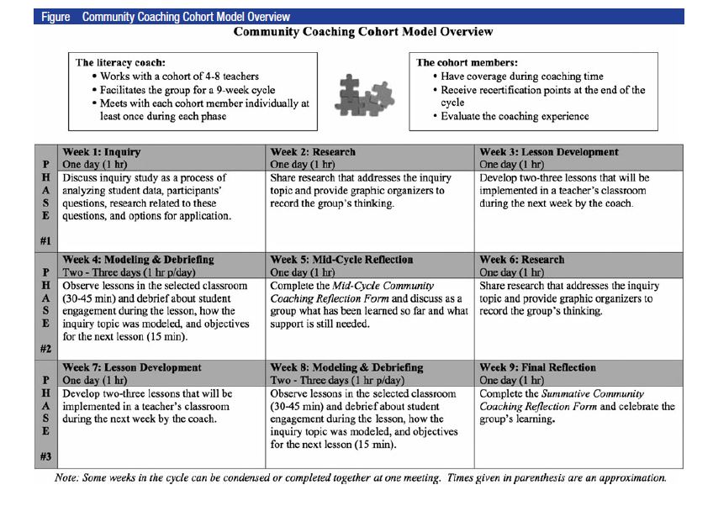
Section III: CCCM description
Notes:
Lacen

Slide 11
Section III: CCCM overview
Methods
  On-going, Job-embedded, Collaborative, Reflective, Inquiry-based, Data-driven
Materials
  COW materials (poems, word lists, big books, sentence strips, pointers, ect.)
  Graphic Organizers
Techniques/Strategies
  Modeling (finger-pointing, read-alouds, word ID)
  Explicit Teaching (directionality, spacing of words, ect.)
  Variety of activities and reading types (choral, echo, independent)
  Independent practice
Notes:
Jen

Slide 12
Section III: CCCM implementation
Spring 2015: Present to the school principal for approval
Teacher Work Week, Fall 2015: Introduce CCCM to kindergarten team
End of Teacher Work Week, Fall 2015: Teachers submit Google Doc for Availability
1st week of school: Formal CCCM model will begin
Plan continues for 9 weeks
Week 5: Teachers complete the Mid-Cycle Community Coaching Reflection Form
End of 9 weeks: Teachers complete the Summative Community Coaching Reflection Form
Notes:
Lacen

Slide 13
Section IV: pD plan introduction
During Teacher Work Week:
One-hour meeting
Ice-breaker activity (visual representation)
Discussion/share
Introduce CCCM model to teachers
Questions and concerns regarding the implementation process
Teacher Google Doc
Notes:
Jen-Explain Ice-Breaker activity

Slide 14
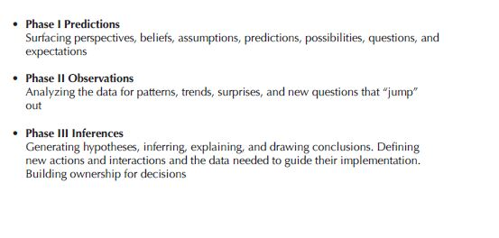
Section IV: pD plan inquiry meeting
During 1st Week of School:
One-hour meeting, phase 1 of model
Protocol, Data Driven Dialogue Tool
Analyze spring 2015 PALs
kindergarten data
Notes:
Jen

Slide 15
Section IV: pD plan research meeting
During 2nd Week of School:
One-hour meeting, phase 1 of model
Protocol, Block Party
Discuss thoughts and experiences
Guided by previous session’s inquiry topics
Team analyzes COW strategy and instructional practice research in partners
Team records information and reactions to COW research using graphic organizers
Notes:
Lacen-Explain block party (quotes)

Slide 16
SECtion iv: pd plan support
Short-term
  Assist in developing COW literacy lesson plans
  Assist in incorporating research-based instructional practices/strategies
  Assist teachers with selecting materials/resources
  Lesson observations and debriefs
Long-term
  Assist teachers in revisiting research topics
  Discuss student growth and teacher reflections
  Assist in developing COW literacy lesson plans
Notes:
Lacen

Slide 17
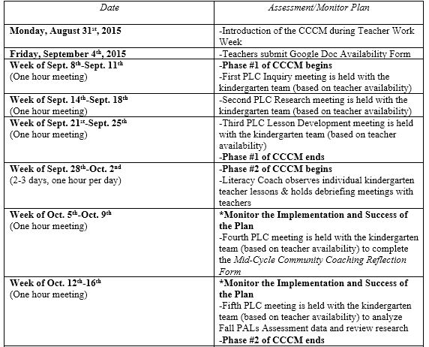
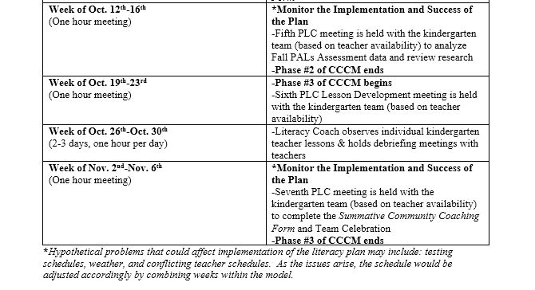
Section v: Timeline for implementation
Notes:
Jen- Explain Schedule
Lacen- Explain hypothetical problems

