Slide 1
Plant and Animal Habitats
Second Grade Science Text Set
MARY LACEN KINKEL

Slide 2
Text Set
Grade level: Second grade
Subject: Life Science
Topic: Plant and Animal Habitats
Rationale:
Our planet Earth is the home to many different types of plants and animals. All living organisms, including humans, live within a particular habitat. Each unique habitat, land or water, contains specific features to support certain plant and animal populations. These plant and animal populations depend on one another in order to survive. The interdependence between living organisms and their nonliving surroundings can be altered by both human and natural influences. As lifelong learners, it is essential that students gain an understanding and respect of caring for the Earth’s environment in which they coincide with these plant and animal habitats.
Topic Objectives:
The students will be able to…
Understand that habitats consist of living organisms and nonliving surroundings within a system.
Recognize the interdependence of living organisms and their nonliving surrounding within a habitat.
Recognize various habitats, land and water, on planet Earth.
Identify the basic essential components needed for survival within a habitat: food, water, shelter or cover, and space.
Understand that plant and animal habitats can change due to human and natural influences.

Slide 3
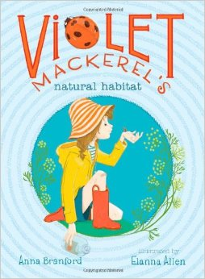
Violet Mackerel’s Natural Habitat by Anna Branford
Branford, A. (2013). Violet Mackerel’s natural habitat. New York, NY: Atheneum Books for Young Readers.
Level: Average-Above Genre: Fiction
Violet Mackerel’s Natural Habitat is a fictional text about a seven year old girl and her relationship with a ladybug named Small Gloria. Victoria finds Small Gloria in a garden. She decides to create a new habitat for Small Gloria in a jar and feeds her cheese toast. One morning, Violet finds Small Gloria upside down in her jar. Violet learns that living things need to grow and live within their natural habitats. Through this experience, Violet begins to appreciate her own habitat with her big sister, Nicola.
This text provides readers with a meaningful purpose, that they can easily recognize. All living organisms live and grow best within their natural habitats, just like children. A child’s home is a place where they live, learn, and grow. Although it may be tempting to have an insect, such as a ladybug, as a pet, it is best to leave it where it belongs. The text allows students to make connections with Violet and foster an appreciation for their own unique habitats.
(Linguistic)

Slide 4
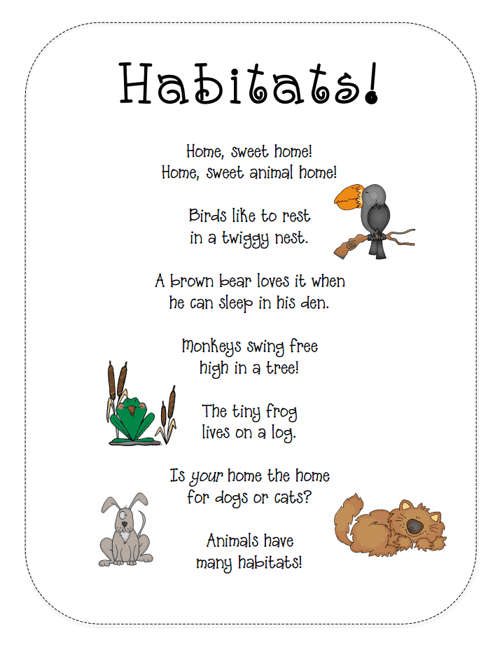
Habitats Poem
Clausen, T. (2012). Habitats poem. Retrieved from www.dragonfliesinfirst.com
Level: All Genre: Poetry
Habitats is a rhythmic poem about various animal homes. The poem includes animals such as birds, a bear, monkeys, a frog, dogs, and cats. All of the animals within the poem live in different homes or habitats, both on land and on water. This short poem fosters that fact that animals live in many habitats. This poem is excellent for both echo and choral reading.
This poem includes many common animals known to children. The students can make predictions as to which home each animal lives in: a nest, a den, a tree, and a log. In order for students to make these predictions, they must activate their prior knowledge of these animals. The students can also make text to self connections if these types of animals live within their habitats, especially within their own home if their families have dogs or cats.
“Home, sweet home! Home, sweet animal home! Birds like to rest in a twiggy nest. A brown bear loves it when he can sleep in his den. Monkeys swing free high in a tree! The tiny frog lives on a log. Is your home the home for dogs or cats? Animals have many habitats!”
(Linguistic)

Slide 5
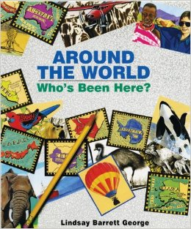
Around the World: Who’s Been Here? By Lindsay Barrett George
George, L. B. (1999). Around the world: who’s been here?. New York, NY: Greenwillow Books.
Level: All Genre: Picture Book
Around the World: Who’s Been Here is one of many picture books in the Who’s Been Here series. The reader follows Miss Lewis as she travels the world. Animals, plants, and habitats are captured and described through pictures, sketches, and letters that Miss Lewis sends to her students. Students explore each page by answering the question, “Who’s been here?”.
This text includes many animals in a variety of habitats. The students must activate their prior knowledge in order to answer the question, “Who’s been here?”. Descriptive clues are given on each question page to help students visualize the corresponding animal, before reading the correct answer. This allows students to predict which animal will be found of the following page.
Additional Picture Books by Lindsay Barrett George (Habitats):
In the Woods: Who’s Been Here? (1995)
In the Snow: Who’s Been Here? (1995)
Around the Pond: Who’s Been Here? (1996)
In the Garden: Who’s Been Here? (2006)
(Linguistic)

Slide 6
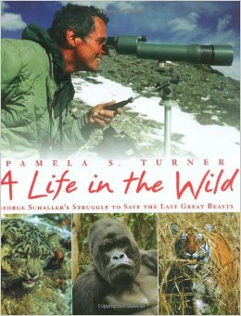
A Life in the Wild By Pamela S. Turner
Turner, P. S. (2008). A life in the wild. New York, NY: Farrar, Stratus, and Giroux.
Level: Above Genre: Biography
A Life in the Wild is a biography about George Schaller’s fifty year struggle to save the world’s last great wild beasts and their environments. George Schaller proved that it is possible to explore and study wild animals within their habitats. Throughout his mission, he traveled to several locations: Alaska, Africa, India, Asia, and many more. He has study wild animals such as grizzly bears, gorillas, lions, tigers, snow leopards, etc. His mission led him to advocate for animal protection for over 190,000 square miles of habitats around the world.
This text takes readers on an incredible authentic adventure. A Life in the Wild contains George Schaller’s journey, experiences, photos, and descriptions of the animal habitats. The students can ask questions about the text before, during, and after reading George Schaller’s biography. The text allows students to determine the importance of his journey to conserve wild animal habitats.
(Linguistic)

Slide 7
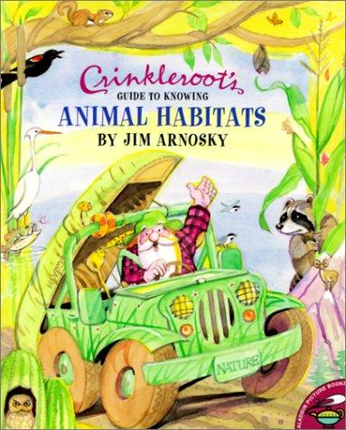
Crinkleroot’s Guide to
Knowing Animal Habitats by Jim Arnosky
Arnosky, J. (1997). Crinkleroot’s guide to knowing animal habitats. New York, NY: Simon & Schuster Books for Young Readers.
Level: Below-Average Genre: Nonfiction
Crinkleroot’s Guide to Knowing Animal Habitats is a nonfiction text that explores several different habitats: wetlands, woodlands, grasslands, drylands, etc. Crinkleroot, the habitat expert, travels in his green jeep to discover over eighty animals in their natural environments. This guide provides students with tips in order to identify animals within their own habitats. Several picture of these animals are provided and labeled within the text.
This text contains several animals and habitats for the reader to discover. The students can activate their prior knowledge of these animals and habitats. Where have they seen the animals before? What did the animals’ home or habitat look like? The students can make connections between many different types of animals and their unique habitats. The text allows students to learn how to identify animals they coincide with within their own habitats.
(Linguistic)

Slide 8
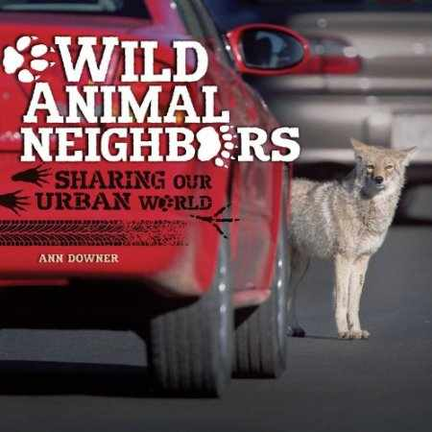
Wild Animal Neighbors By Ann Downer
Downer, A. (2014). Wild animal neighbors. Minneapolis, MN: Twenty-First Century Books.
Level: Average-Above Genre: Nonfiction
Wild Animal Neighbors is a nonfiction text about the wild animals who are sharing our urban world. Wild animals are appearing in areas least expected by humans. Some of the animals have arrived by accident, but some have come to live. As the human population reaches seven billion and growing, the animal populations are losing more and more space. Their natural habitats are constantly changing and moving, resulting in our wild animal neighbors.
This text presents readers with an important real world problem regarding humans and wild animals. As our space increases, their space decreases. The students can explore a variety of questions. How can we coexists with these wild animal neighbors? How are our actions affecting their survival? How will this affect our future? What would you do? The text allows students to brainstorm and determine what needs to be done in order for people and animals to live side by side within the same habitats.
(Linguistic)

Slide 9
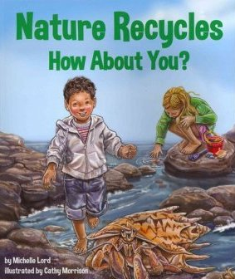
Nature Recycles How About You? By Michelle Lord
Lord, M. (2013). Nature recycles how about you?. Mt. Pleasant, SC: Sylvan Dell Publishing.
Level: All Genre: Nonfiction Picture Book
Nature Recycles How About You? is a nonfiction picture book that contains a collection of animal facts. These facts explain how different animals from all over the world use recycled materials, including plants, within their own habitats. They use recycled materials for shelter, protection, and food. The text includes a variety of land and water animals and an explanation of how they recycle. It also includes how water recycles through the phases of the water cycle. Additional interactive resources and activities relating to this text can be found at http://sylvandellpublishing.com/
This text will inspire readers to conserve and protect the Earth’s environment. Habitats are constantly changing due to the natural process of recycling. On every other page, the text states the animal that recycles and then asks, “How about you?”, The students can collaborate with one another to discuss how they can recycle, which in return will benefit plant and animal habitats. The text provides students with an authentic purpose to recycle in order to conserve, protect, and enhance our environment.
(Linguistic)

Slide 10
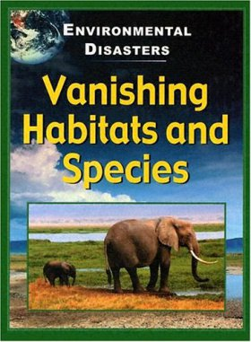
Vanishing Habitats and Species By Jane Walker
Walker, J. (2005). Vanishing habitats and species. Mankato, MN: Stargazer Books.
Level: Average-Above Genre: Nonfiction
Vanishing Habitats and Species is a nonfiction text about the world’s environmental disasters. These disasters are caused by both natural and human influences. They are taking place in locations such as rainforests, wetlands, coral reefs, forests, and grasslands. The text explores and investigates why plant and animal habitats are being destroyed, why animal populations are decreasing, and why species are becoming extinct all over the world.
This text contains several animals and habitats that have been affected by these environmental disasters. Although some disasters are natural, some are solely caused by humans. For example, humans have caused damages to the atmosphere due to pollution and global warning. The students can apply their gained knowledge of human caused disasters to predict what will happen if we continue to pollute our Earth. This text is excellent to use while making connections: text to text, text to self, and text to world.
(Linguistic)

Slide 11
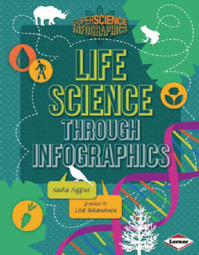
Life Science Through Infographics By Nadia Higgins
Higgins, N. (2014). Life science through infographics. Minneapolis, MN: Lerner Publications Company.
Level: All Selection: Visual Representations
Life Science Through Infographics is a nonlinguistic text that includes visual representations such as charts, maps, and illustrations. These charts, maps, and illustrations are used to tell a visual story. This volume includes a table of contents, a glossary, further information, and an index.
This text displays several big key habitat concepts in a clear and condensed way that is easier for students to read and comprehend. They are able to sort through and identify important information. The concepts can be explore by examining the charts, maps, and illustrations along with reading the accompanying text. The text includes a short test that examines a student’s interest in life science.
“When you walk down the sidewalk, do you stop to look at plants and bugs?”
“Do you enjoy pondering Big Questions, like “What is life?”
“Do you like to geek out on amazing facts?”
“Have you and your friends ever pretended to be bacteria?”
“Did you answer yes to any of those questions? Congratulations! You have what it takes to be a budding biologist, a scientist who studies living things.”
This shot test is a wonderful introduction to set the purpose for the remainder of the text. It also peeks the reader’s interest and increases their motivation to explore what the text has to offer.
(Nonlinguistic)

Slide 12
Life Science Through Infographics By Nadia Higgins
Visual Representations:
Organisms Rule!
Party, Evolution Style
Rock Stars
Our World’s Worlds
Thank You, DNA
Let’s Get Microscopic
Amazing Bonds
The Circle of Life
Eat and Be Eaten
The Wow-O-Meter of Life
The Bad News
10 Ways to Live Green
(Nonlinguistic)

Slide 13

Brain Pop Jr. Habitat Movies
Brain Pop Jr.: Habitat movies. (1999-2014). Retrieved from www.brainpopjr.com
Level: All Selection: Movies
Brain Pop Jr. is an interactive website intended for Kindergarten through Third grade students. Brain Pop Jr. provides a variety of movies, activities, games, etc. in the following content areas: science, health, reading and writing, social studies, arts and technology, and mathematics. This website includes several movies regarding plant and animal habitats. Each three to five minute movie is shown in a Kindergarten through Third grade perspective.
These videos can be viewed with close caption to reinforce reading and listening skills. Several notebook questions are asked throughout each movie to promote active discussion. Corresponding activities can be used before, during, and after viewing the movies to reinforce numerous comprehension strategies. These activities include: a game, an activity, “Belly Up” comic, pop a joke, word wall words, lesson ideas, draw about it, write about it, read about it, talk about it, and movie quizzes (easy and hard). Students can interact with Brain Pop Jr. independently, with partners, small groups, or in a whole group setting.
(Nonlinguistic)

Slide 14
Brain Pop Jr. Habitat Movies
Habitat Movie Topics:
Freshwater Habitats
Artic Habitats
Ocean Habitats
Rainforests
Desert
Forests
(Nonlinguistic)

Slide 15
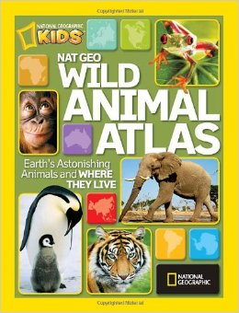
National Geographic Wild Animal Atlas
National Geographic. (2010). National Geographic wild animal atlas. Washington, DC: National Geographic Kids.
Level: All Selection: Maps (Atlas)
National Geographic Wild Animals Atlas explores Earth’s astonishing animals and where they live through the use of maps. This kid friendly atlas contains several animals, plants, habitat pictures, and informational facts. Each colorful map is easy to read and understand. Various animals are displayed in their region’s or habitat’s “spotlight”.
This atlas includes maps that display plant and animal habitats in a fun, interesting, and exciting way. These maps are highly appealing to young children, due to its kid friendly maps. National Geographic provides an age appropriate atlas that is useful for learning essential geography. The students will be able to visualize the location of numerous habitats around the world. This text will allow students to identify unique plant and animal habitats within or near their own natural habitats.
(Nonlinguistic)

Slide 16
Additional Resources and Electronic Activities
“I Got A Habitat” Song by The Bumblemen
http://www.youtube.com/watch?v=H_CSlLIuVZs
Creature Feature
http://kids.nationalgeographic.com/animals.html
Pond Seek and Find
http://www.sheppardsoftware.com/content/animals/kidscorner/seekandfind/seekandfindpond.htm
Ocean Seek and Find
http://www.sheppardsoftware.com/content/animals/kidscorner/seekandfind/seekandfindcoral.htm

Slide 17
Additional Resources and Electronic Activities
The Great Habitat Match-Up
http://www.scholastic.com/magicschoolbus/games/habitat/
Pancake Wood
http://www.rfs.org.uk/game/game.html
Clean Air Kids
http://www.clean-air-kids.org.uk/Games/index.html
Switch Zoo
http://switchzoo.com/zoo.htm

Slide 18
Additional Resources and Electronic Activities
Animal Homes
http://www.bgfl.org/bgfl/custom/resources_ftp/client_ftp/ey/science/animal_h/level1/level1-1.html
Draw That Habitat
http://www.pbslearningmedia.org/
Every Living Things Has A Home
http://www.e-learningforkids.org/environmental-skills/lesson/every-living-thing-has-a-home/
Habitat Maker
http://mrnussbaum.com/habitatmaker2/

